Slide 1
LI/SC – 21/2/24
Learning Intentions
Success Criteria
Examine the site and situation of Papua New Guinea. Examine SPICESS in relation to the environmental change taking place in PNG.
Outline site and situation features for Papua New Guinea. For each part of SPICESS, outline what each means using PNG environmental change.

Slide 2

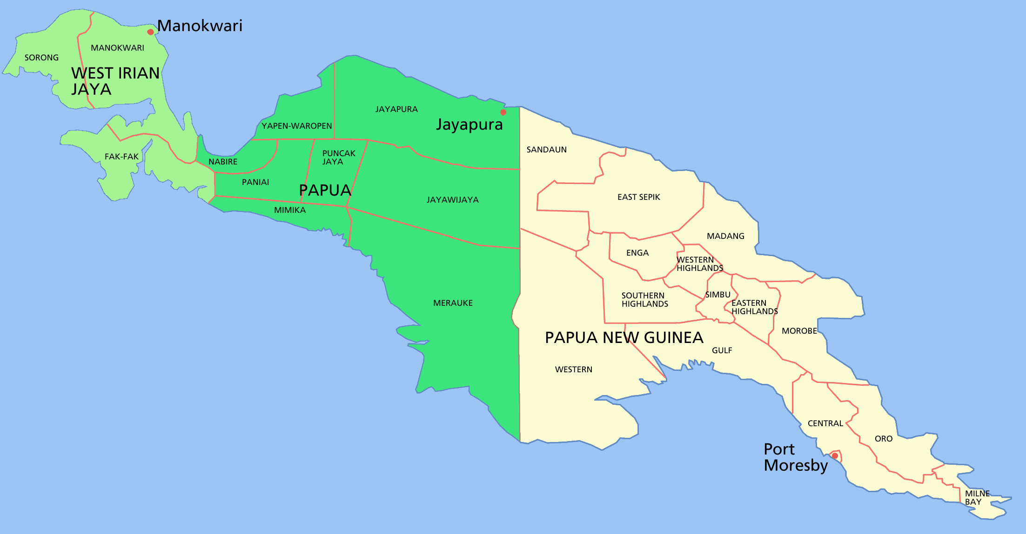
Year 10 Geography Comparative Case Study LAND
Country:
Papua New Guinea (PNG)

Slide 3
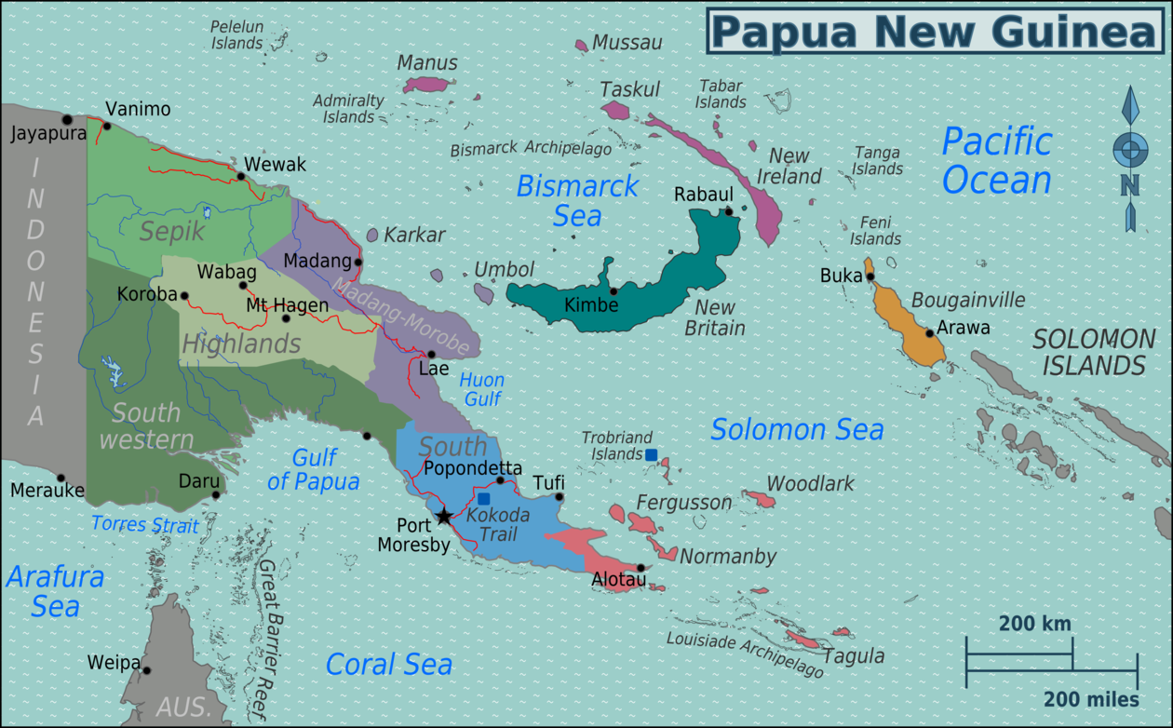
MAP – Papua New Guinea (PNG)
This Photo by Unknown Author is licensed under CC BY-SA

Slide 4
Facts - Papua New Guinea (PNG)
Location – located in Pacific region (southwestern Pacific)
Developing Country.
Population – approximately 10 million people.
10,515,788 (2024)
Population density (per sq km) – 23 people per sq km
Capital City – Port Moresby
% living in urban areas – 13.7%
Geography – comprises of 600 small islands and approximately 5,150kilometres of coastline.
Shares a land border with Indonesia.
PNG has approximately 800 Indigenous language groups.

Slide 5
Land degradation from deforestation and management in PNG
PLACE: SITUATION
Situated/located approximately 160km north of Australia.
Situated approximately 4100km north east of Perth.
Port Moresby is the capital city.
Port Moresby is situated at latitude 9° 26’ S and longitude 147° 10’ E.

Slide 6

Land degradation from deforestation and management in PNG
ENVIRONMENT:
Papua New Guinea’s forest contain 5% of the world’s (global) biodiversity. PNG only covers one percent of the Earth’s total land area.
Site: Physical environment – hot, humid tropical climate which happens all year round.
Two distinct seasons – Wet (December – March) and Dry (June – September).

Slide 7
Land degradation from deforestation and management in PNG
(Environment)
Site Features of PNG:
Island.
A mountainous zone known as the Highlands, extends from the west to the southeast.
Mountains reach elevations of approximately 4000 metres.
Country’s highest point is 4509 metres (Mount Wilhem)
Steeply sloping mountain areas.
PNG – 4 distinct regions – Southern, New Guinea Islands, Highlands and Momase.

Slide 8
Land degradation from deforestation and management in PNG
SPACE:
Approximately 80% of the country is classified as forest land.
Third largest tropical forest area in world (Amazon and Congo basin).
More than 75% is classified as undisturbed by human activities or ‘intact’ (not cleared).

Slide 9

Land degradation from deforestation and management in PNG
SCALE:
Scale of Change over time (temporal distribution)
Look at: Global Forest Watch
https://www.globalforestwatch.org/dashboards/country/PNG/

Slide 10
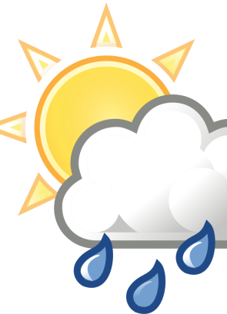
Land degradation from deforestation and management in PNG
INTERCONNECTION:
Forests help to regulate climate
People have an interconnection to the forest.
Forests help to reduce soil erosion
Forests absorb CO2

Slide 11
Land degradation from deforestation and management in PNG
CAUSES OF DEFORESTATION:
Clearing the land for:
Logging
Infrastructure
Mining – gold and nickel
Population growth (e.g. building infrastructure and settlements)
Subsistence agriculture
Commercial and industrial agriculture – e.g. oil palm plantations, cocoa and coffee.

Slide 12
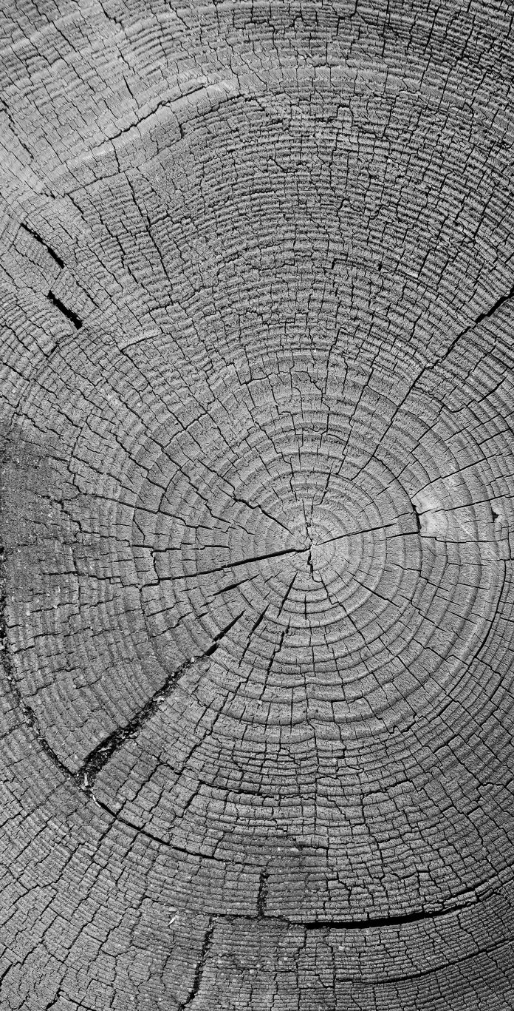
Land degradation from deforestation and management in PNG
LIKELY CONSEQUENCES
(IMPACTS/EFFECTS) OF DEFORESTATION:
- Dislocation of indigenous people (Ecosystem Services - Spirituality)
Climate change
Loss of biodiversity – decline/reduction in the number, type and variety of species.
Soil degradation
Habitat loss and fragmentation
Reduces the water cycling services provided by trees.
Modified climate - Less trees (forest) means less carbon dioxide (CO2).
Land degradation – deforestation has led to soil erosion, reduced soil fertility, potentially increased flooding.

Slide 13

Can you categorise the impacts using SHEEPT?
- Dislocation of indigenous people (Ecosystem Services - Spirituality)
Climate change
Loss of biodiversity – decline/reduction in the number, type and variety of species.
Soil degradation
Habitat loss and fragmentation
Reduces the water cycling services provided by trees.
Modified climate - Less trees (forest) means less carbon dioxide (CO2).
Land degradation – deforestation has led to soil erosion, reduced soil fertility, potentially increased flooding.

